Slide 1


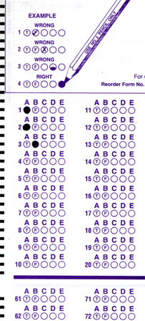
Setup:
Prepare your scantron:
Use
a pencil,
not a pen!
Fill in your name and fill the bubbles under
your name.
LAST NAME FIRST, First name second
Put your 4-digit code instead of “IDENTIFICATION NUMBER”.
--- (The last 4 digits of your OleMiss ID.)
Question # 1: answer A
Question # 2: answer E
Question # 3: answer E
Reading assignment
Surveying the Stars, Chapter 15, pp. 488-512
Please take a moment to mute your cell phone!

Slide 2
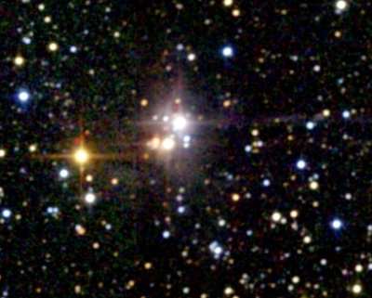
The spectral type (color) of stars
Stars come in color:
The human eye can’t see the color of faint objects
We see the color of the brightest stars only
But the color is still there
Photos bring it out
What makes stars colored?
Temperature
Wien’s law:
Hot objects glow,
the color of their light changes
from red to blue as they get hotter:
Temperature [K] = 2880 / wavelength [μm]
(Wilhelm Wien, 1896)
The color of stars is described by the spectral type:
O , B, A, F, G, K, M
Blue (40,000 deg)
Red (1000 deg)
White (10,000 deg)
Yellow (6000 deg): like THE SUN

Slide 3
Questions coming …

Slide 4
Question 4
sec
30
29
28
27
26
25
24
23
22
21
20
18
17
16
15
14
13
12
11
10
9
8
7
6
5
4
3
2
1
0
19
Can we see the color of the stars in the sky
(without a telescope)?
A No, because stars do not have color.
B No, because the human eye cannot see the stars’ color.
C Only of the brightest stars.
D Yes, all stars can be seen in color by the human eye.
Next question coming …

Slide 5
Question 5
sec
30
29
28
27
26
25
24
23
22
21
20
18
17
16
15
14
13
12
11
10
9
8
7
6
5
4
3
2
1
0
19
What spectral type is the Sun?
A Type O.
B Type A.
C Type G.
D Type K.
E Type M.

Slide 6
Stars: temperature - examples
Wien’s law: color - temperature relationship
Temperature [K] = 2880 / wavelength [μm]
(photospheric temperature)
Examples:
Sun yellow (500 nm) T → 6,000 degrees
Sirius white (300 nm) T → 10,000 degrees
Betelgeuse red (1000 nm) T → 3,000 degrees
G
A
M
Spectral types mean color:
O B A F G K M
20000 K
8000 K
3000 K

Slide 7
Questions coming …

Slide 8
Question 6
sec
30
29
28
27
26
25
24
23
22
21
20
18
17
16
15
14
13
12
11
10
9
8
7
6
5
4
3
2
1
0
19
Which one is the least hot star on the list?
A A red star.
B A blue star.
C A white star.
D A yellow star.
E An orange star.
Next question coming …

Slide 9
Question 7
sec
30
29
28
27
26
25
24
23
22
21
20
18
17
16
15
14
13
12
11
10
9
8
7
6
5
4
3
2
1
0
19
What does Wien’s law say?
A That the color of the stars is related to the temperature of the star.
B That stars come in different colors.
C That there are seven spectral types of stars.
D That hotter stars are brighter.
E That a red star is brighter than a blue star.

Slide 10
Stefan-Boltzmann law:
Hot objects glow,
and the strength of the glow increases as they get hotter.
Each square inch of surface radiates this much power:
I/A = σ T⁴
I[Watt]=power, T[K]=temperature, A[m²]=surface area
Boltzmann constant σ = 6.67 x 10⁻⁸ [in units of W/(m²K⁴)]
(Josef Stefan, Ludwig Boltzmann, 1877)
For a star:
• The (total) power I is also called luminosity, L=I
• Absolute magnitude M is the same thing, too
but with different math
M = - 2.5 lg L/L_{Vega}
• The surface area is A=4r²π (a sphere)

Slide 11
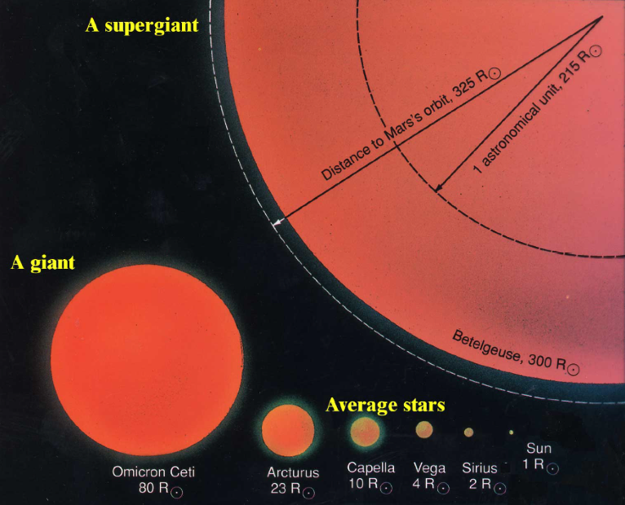
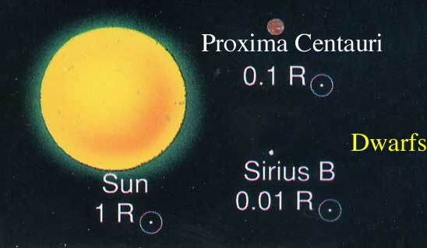
The size of stars
How big are the stars?
Can’s see size in telescope - all stars are just dots.
Once we know
• the absolute magnitude (M) solve M = - 2.5 lg L/L_{Vega} for L
• the temperature (T) solve L/A = σ T⁴ for A
• calculate the size (radius r) solve A=4r²π for r
The result:
a wide variety of sizes:

Slide 12
Questions coming …

Slide 13
Question 8
sec
30
29
28
27
26
25
24
23
22
21
20
18
17
16
15
14
13
12
11
10
9
8
7
6
5
4
3
2
1
0
19
How do we know the sizes of stars?
A Observing how large the star looks in the telescope, and using the distance to the star from parallax.
B We don’t know it at all.
C Calculating it from knowledge of absolute brightness and temperature.
D We know the size of stars only from spaceships that went there and returned.

